Slide 1

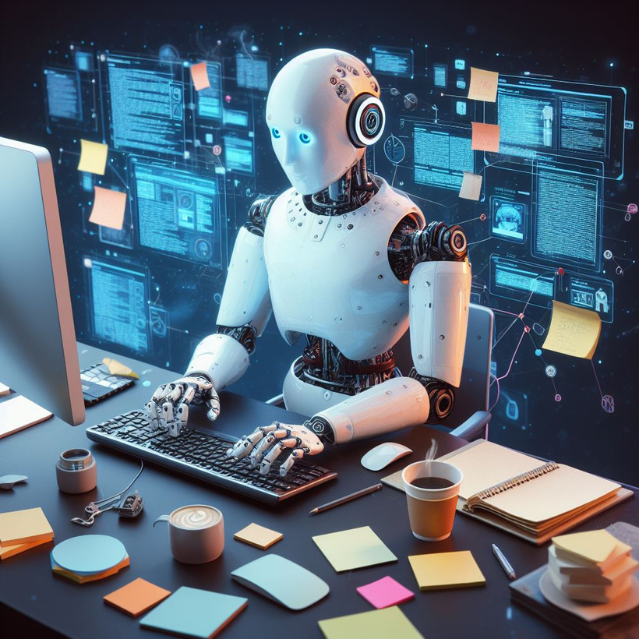
TEXT GENERATION
Using Large Language Model

Slide 2
PROBLEM STATEMENT:
Problem: Inefficient manual cold email creation, lack of personalization, and difficulty in tailoring messages.
Goal: To develop an LLM-powered app that automates personalized cold email creation, enhances efficiency, improves response rates, and provides customization options.

Slide 3



CONTENTS
1
Problem Statement
2
LLM Modole & Intregation With Groq Cloud
3
Langchain Framework
4
Web scraping
5
Vector Database chromadb
6
Create a Cold Email for Text Generation
7
Deployment on Gradio & Streamlit UI

Slide 4


1
What is LLM?
LLM stands for Large Language Model. It's a type of artificial intelligence that is trained on massive amounts of text data to understand and generate human language.
Translation
Summarization
Question answering
Creative writing

Slide 5


2
LLaMA 3.1 LLM model:
LLAMA 3.1 IS AN OPEN-SOURCE MODEL
HIGH PERFORMANCE
EASILY GET API KEY WITH GROQ CLOUD
TRAINED ON 70 BILLION PARAMETERS.
*groq clould is the fastest inference in the world

Slide 6
3
What is Langchain?
LangChain is a framework that makes it easier to build applications using large language models (LLMs). It provides a modular and flexible way to combine LLMs with other tools and data sources.
Modularity
Flexibility
Ease of use

Slide 7
4
web scraping
Web scraping is the process of extracting data from websites using automated scripts.
Langchain WebBaseLoader to load all text from HTML webpages into a document format that we can use for further analysis.

Slide 8





Tech Architecture
Extract Jobs in json format
experience
Job description
skills
jobs
cold mail
Careers page
LLM
LLM
Vector Database
portfolio links

Slide 9


Vector database vs relational database
5
chromadb
mysql
Efficient - similarity search
Scalable- for large datasets
Flexible -data storage
Integrates with ML frameworks
Specialized indexing techniques
Limited understanding .
Inefficient search Scalability
issues Complex integration
Lack of indexing

Slide 10



6
potential problems
RESULT DEPENDS ON TYPE HTML PAGE
PRIVACY AND DATA CONCERNS

Slide 11
7
Deployment
GRADIO
STREAMLIT

Slide 12




website : https://www.icicicareers.com/website/Jobs/Hot-Jobs/2490146.html
Lets’s put a url of Job opening ....

Slide 13
...

Slide 14
Result:
Subject: Expert Application Security Solutions for ICICI Bank
Dear Hiring Manager,
I came across the job description for the Application Security Manager role at ICICI Bank and was impressed by the organization's commitment to providing secure services to its customers. As a Business Development Executive at imarticus learning, I believe our company can provide the necessary expertise to support your application security needs.
Our team at imarticus learning has extensive experience in developing and implementing secure solutions for various industries. We understand the importance of staying up-to-date with the latest security technologies, including Cloud security and recent trends. Our expertise in Network Security technology, including Firewall, IPS, VPN, Gateway security solutions, proxy, and web filtering, aligns with the requirements of the Application Security Manager role.
We have a proven track record of delivering scalable and efficient solutions that meet the highest security standards. Our portfolio includes:
* DevOps solutions that ensure seamless integration of security protocols (https://example.com/devops-portfolio)
* Cloud-based security solutions that provide real-time threat detection and mitigation (https://example.com/ml-python-portfolio)
* Mobile application security solutions that protect against vulnerabilities and data breaches (https://example.com/kotlin-android-portfolio)
Our team is well-versed in various security frameworks, including OWASP, SANS, and MITRE ATT&CK. We can provide guidance on application security best practices, support remediation efforts, and track open issues to ensure timely remediation.
I would be happy to discuss how imarticus learning can support ICICI Bank's application security needs. Please let me know if you would like to schedule a call to explore this further.
Best regards,
Mayank
Business Development Executive
imarticus learning

Slide 15

5
Use of text generation
Content Creation
Customer Service
Language Translation
Education
Research and Analysis

Slide 16
THANK YOU

